Slide 1
L ONG TERM E VOLUTION UICC: RxM over HTTP GTS (Global Technical Support) detlef.balks@morpho.com

Slide 2
RxM over HTTP
Content
Protocols and Standards
Elements and Communication Flow
Product Configuration
Notes:
1

Slide 3
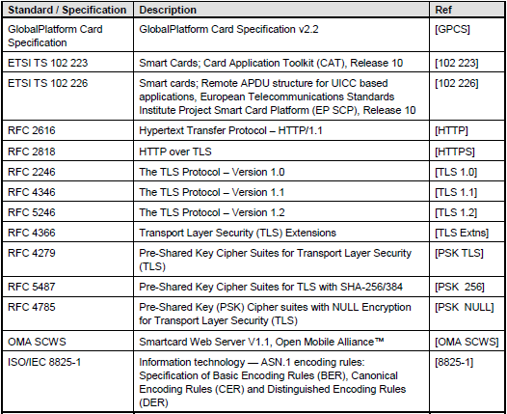
RxM over HTTP: Protocols & Standards
Standards

Slide 4
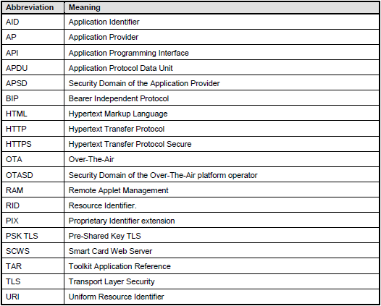
RxM over HTTP: Protocols & Standards
Abbreviations

Slide 5



RxM over HTTP: Protocols & Standards
RxM – Remote Application / File Management over secured HTTP
OTA SD
ME
OTA Server
BIP
TCP/IP
TLS
HTTPS
HTTP Client
HTTP Server
Notes:
4

Slide 6
RxM over HTTP: Protocols & Standards
Transmission Control Protocol (TCP)
One of the core protocols of the Internet protocol suite (IP), often called TCP/IP
Provides reliable, ordered, error-checked transport
It resides at the transport layer
Notes:
5

Slide 7
RxM over HTTP: Protocols & Standards
Hypertext Transfer Protocol (HTTP)
Protocol to transfer hypertext
Functions as a request-response protocol in the client-server computing model
Client submits request message to server
Server returns response message to client
HTTP resources are identified on network by Uniform Resource Identifiers (URIs)
HTTP defines methods to indicate desired action (e.g. POST, GET, PUT, DELETE,…)
Notes:
6

Slide 8
RxM over HTTP: Protocols & Standards
Transport Layer Security (TLS)
Cryptographic protocol designed to provide communication security over the Internet
Predecessor SSL (Secure Sockets Layer)
Application Protocols (such as HTTP) can operate with or without TLS
Client indicates to server whether to set up TLS connection or not
Client and server, when using TLS, negotiate a connection with TLS handshake procedure
During handshake client and server agree on parameters for connection's security
TLS uses long term public and secret keys to exchange a short term session key
Session key protects data flow between client and server
Notes:
7

Slide 9
RxM over HTTP: Protocols & Standards
Transport layer security pre-shared key cipher suites (TLS-PSK)
Set of cryptographic protocols that provide secure communication based on pre-shared keys (PSKs)
Pre-shared keys are symmetric keys shared in advance among the communicating parties
PSKs benefits: - Can avoid public key operations in performance-constrained environments - More convenient key management in closed environments
Notes:
8

Slide 10
RxM over HTTP: Protocols & Standards
Hypertext Transfer Protocol Secure (HTTPS)
Communications protocol for secure communication over a computer network
Technically not a protocol in itself but the result of layering HTTP on top of TLS protocol
Security of HTTPS is therefore the one of the underlying TLS
Notes:
9

Slide 11

RxM over HTTP: Protocols & Standards
OMA Smartcard Web Server V1.2
Smart Card Web Server (SCWS) is a HTTP server implemented in the Smart Card embedded in the mobile device (e.g. SIM, (U)SIM, UICC)
Offers Smart Card based services by using HTTP protocol
Smart Card provides a web server for the user to browse using the device WEB browser
Web server is accessible via gateway that translates TCP/IP protocol to another local protocol between the device and the Smart Card
HTTP requests/responses are sent directly to the SCWS over the local Smart Card-device protocol

Slide 12
RxM over HTTP: Protocols & Standards
OMA Smartcard Web Server V1.2
SCWS Remote Administration protocol used by Remote Administration Server to update content of SCWS
SCWS Remote Administration protocol is based on HTTP protocol
HTTP client being implemented by the SCWS Administration Agent in the Smart Card
HTTP server being implemented by the Remote Administration Server
HTTP over TLS (HTTPS) is used to secure the exchange

Slide 13

RxM over HTTP: Protocols & Standards
GlobalPlatform Card
Remote Application Management over HTTP
Card Specification v2.2 – Amendment B (Version 1.1.1)
OMA SCWS defines mechanism for securely uploading static SCWS content (HTML pages) from remote entity to card
GP handles Card Content Management and can be used independently of SCWS
Establish HTTPS connection between Application Provider (AP) and its Security Domain (APSD)
APSD (on card) acts as HTTPS client, and AP (remote server) acts as an HTTPS server
Connection is used to send remote APDU format string to the APSD

Slide 14
RxM over HTTP: Elements & Communication Flow
RxM – Remote Application / File Management over secured HTTP
OTA SD
OTA Server
Trigger (Push SMS)
Open BIP Channel / TCP Connection
TLS Handshake
HTTPS Request / HTTPS Response
Close BIP Channel / TCP Connection
HTTP Client
HTTP Server
Notes:
13

Slide 15
RxM over HTTP: Elements & Communication Flow
Security Domain
Acts as HTTP Client
Establishes connection with HTTP Server (Remote Administration Server)
Starts (or resumes) administration session used to receive APDU commands
Responsible for retry and reconnection management in case of communication breakdown
Implements the SCWS administration agent
Uses TLS protocol to secure communications
RFC 2246 [TLS 1.0], RFC 4346 [TLS 1.1], RFC 5246 [TLS 1.2], RFC 2818 [HTTPS]
TLS protocol = GlobalPlatform Secure Channel Protocol '81' (SCP81)

Slide 16
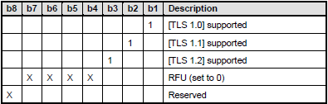
RxM over HTTP: Elements & Communication Flow
SCP81 Configuration
Security Domain may support one or multiple TLS versions
Parameter "i" is formed as a bit map on one byte

Slide 17
RxM over HTTP: Elements & Communication Flow
PSK TLS Cipher Suites
For TLS 1.0 and TLS 1.1:
• TLS_PSK_WITH_3DES_EDE_CBC_SHA defined in RFC 4279
• TLS_PSK_WITH_AES_128_CBC_SHA defined in RFC 4279
• TLS_PSK_WITH_NULL_SHA defined in RFC 4785
For TLS 1.2:
• TLS_PSK_WITH_AES_128_CBC_SHA256 defined in RFC 5487
• TLS_PSK_WITH_NULL_SHA256 defined in RFC 5487
DES=Data Encryption Standard AES=Advanced Encryption Standard SHA=Secure Hash Algorithm

Slide 18
RxM over HTTP: Elements & Communication Flow
PSK TLS key set
PSK TLS key (generating session key)
Freely defined KVN (Key Version Number) and KID (Key Identifier)
DEK key may be used to decrypt or encrypt sensitive data
KVN same as PSK TLS key, KID incremented by one
Example:
PSK TLS session was opened using PSK TLS key with KVN ‘01' and KID ‘14‘
DEK key in this session is identified by a KVN ‘01' and KID ‘15'

Slide 19
RxM over HTTP: Elements & Communication Flow
PSK TLS Key Type
'80‘ DES – mode (ECB/CBC) implicitly known
'82‘ Triple DES in CBC mode
'83‘ DES in ECB mode
'84‘ DES in CBC mode
'85‘ Pre-Shared Key for Transport Layer Security

Slide 20
RxM over HTTP: Elements & Communication Flow
Administration Session Start - Trigger
SD is triggered and communication channel with Remote Server is set up
Triggering of SD may result from: - an external event (e.g. message sent by a remote entity) - an internal event (e.g. timer) - an application using a dedicated API method

Slide 21
RxM over HTTP: Elements & Communication Flow
Administration Session Triggering Parameters
When starting an administration session, the triggered Security Domain shall use parameters to set up connection, security and content of the first request
These parameters shall be retrieved from the message leading to this administration session ("administration session triggering parameters")
If parameters are missing in the triggering message, they shall be completed with parameters of the triggered Security Domain
If parameters are still missing, they shall be completed with parameters of the Issuer Security Domain

Slide 22
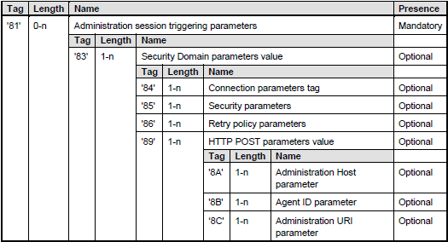
RxM over HTTP: Elements & Communication Flow
Administration Session Triggering Parameters
Administration session triggering parameters are TLV structured values

Slide 23
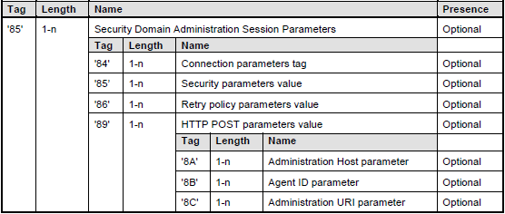
RxM over HTTP: Elements & Communication Flow
Security Domain Administration Session Parameters
Administration parameters may be set during Security Domain installation, inside the application specific parameters, or during Security Domain personalization with the Store Data command

Slide 24

RxM over HTTP: Elements & Communication Flow
Connection Parameters
All needed parameters to establish TCP connection between Administration Agent and the Remote Server
Typically used, if connection between Administration Agent and Remote Server is done over BIP

Slide 25
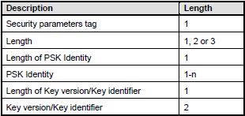
RxM over HTTP: Elements & Communication Flow
Security Parameters
Administration agent shall support a PSK Identity length of at least 32 bytes
1st byte is the key version number of the key
2nd byte is the key identifier of the key

Slide 26
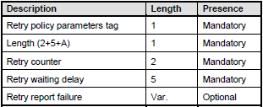
RxM over HTTP: Elements & Communication Flow
Retry Policy Parameters
Retry counter: value of the retry counter used by the retry policy
Retry waiting delay: definition of the time to wait between two retries
Retry Report Failure: typically used to send a message using another communication channel in case of an abort of administration request

Slide 27

RxM over HTTP: Elements & Communication Flow
Administration Host Parameter
Defines "Host" header value
Used by Security Domain when sending POST request

Slide 28

RxM over HTTP: Elements & Communication Flow
Administration URI Parameter
Defines URI value
Used by Security Domain when sending POST request

Slide 29

RxM over HTTP: Elements & Communication Flow
Agent Id Parameter
Defines "X-Admin-From" header value
Used by Remote Server to identify the requester when receiving POST request

Slide 30
RxM over HTTP: Elements & Communication Flow
Administration Session Start – Secure Communication
SD establishes secure communications using its own PSK TLS key
SD knows all parameters needed to establish a connection and to handle its security
Parameters can be parameters of the triggering message or parameters of the SD itself

Slide 31
RxM over HTTP: Elements & Communication Flow
Administration Session Start – Secure Communication
OTA SD
ME
OTA Server
ENVELOPE
(SMS-PP Download)
Trigger SMS
Open Channel
Establish link
BIP Channel
TCP/IP Connection
Initiate TLS Handshake
TLS Handshake
Send first HTTP Request
HTTP over TLS
HTTP Client
HTTP Server
Notes:
30

Slide 32
RxM over HTTP: Elements & Communication Flow
TLS Protocol Records
TLS protocol exchanges records
Records encapsulate data to be exchanged in a specific format
Each record has a content type field that designates the type of data encapsulated
Content Types:
20 ChangeCipherSpec
21 Alert
22 Handshake
23 Application

Slide 33
RxM over HTTP: Elements & Communication Flow
TLS Handshake Protocol
Most messages exchanged during setup of TLS session based on record type ‘handshake’
Message Types (relevant to PSK TLS handshake):
1 ClientHello
2 ServerHello
14 ServerHelloDone
16 ClientKeyExchange
20 Finished

Slide 34
RxM over HTTP: Elements & Communication Flow
PSK TLS Handshake Protocol
OTA SD
OTA Server
ClientHello message
ServerHello message
ServerHelloDone message
ClientKeyExchange message
ChangeCipherSpec record
encrypted Finished message
ChangeCipherSpec record
encrypted Finished message
HTTP Client
HTTP Server
Notes:
33

Slide 35
RxM over HTTP: Elements & Communication Flow
Fetching a Remote APDU Format String
Security Domain sends HTTP POST request
Remote Server sends HTTP response with APDU format string
Security Domain verifies protection and processes APDU format string
Security Domain submits response in a new POST request to the Remote Server, if requested
Remote Server sends next remote APDU format string or a final response

Slide 36
RxM over HTTP: Elements & Communication Flow
Administration Session End
Administration Session ends when all HTTP messages sent by Remote Server were received and processed
Remote Server explicitly ends the session by sending an HTTP response with no "X-Admin-Next-URI" header and with an empty body
Security Domain closes administration session and communication channel

Slide 37
RxM over HTTP: Elements & Communication Flow
Administration Session
OTA SD
OTA Server
TLS Handshake
HTTPS Request POST URI
HTTPS Response 200 OK (Remote C-APDU)
HTTPS Request POST (Remote R-APDU)
HTTPS Response 200 OK (Close Session)
HTTP Client
HTTP Server
Notes:
36

Slide 38
RxM over HTTP: Elements & Communication Flow
Communication Flow: 1st request sent by on-card OTA Security Domain
POST /server/adminagent?cmd=1 HTTP/1.1
Host: 172.96.0.1
X-Admin-Protocol: globalplatform-remote-admin/1.0
X-Admin-From: 0123456789

Slide 39
RxM over HTTP: Elements & Communication Flow
Communication Flow: 1st response sent by remote OTA Server
Command that shall be executed by OTA Security Domain
HTTP/1.1 200 OK
X-Admin-Protocol: globalplatform-remote-admin/1.0
X-Admin-Next-URI: /server/adminagent?cmd=2
Content-Type: application/vnd.globalplatform.card-content-mgt;version=1.0
X-Admin-Targeted-Application: //aid/A000000018/0001
Content-Length: xxxx
CRLF
[command-string]

Slide 40
RxM over HTTP: Elements & Communication Flow
Communication Flow: 2nd request sent by on-card OTA Security Domain
Return of command response
POST /server/adminagent?cmd=2 HTTP/1.1
Host: 172.96.0.1
X-Admin-Protocol: globalplatform-remote-admin/1.0
X-Admin-From: 0123456789
Content-Type: application/vnd.globalplatform.card-content-mgt-response;version=1.0
Content-Length: xxxx
X-Admin-Script-Status: ok
CRLF
[response-string]

Slide 41
RxM over HTTP: Elements & Communication Flow
Communication Flow: 2nd response sent by remote OTA Server
Communication shall be closed
HTTP/1.1 204 No Content
X-Admin-Protocol: globalplatform-remote-admin/1.0
CRLF

Slide 42
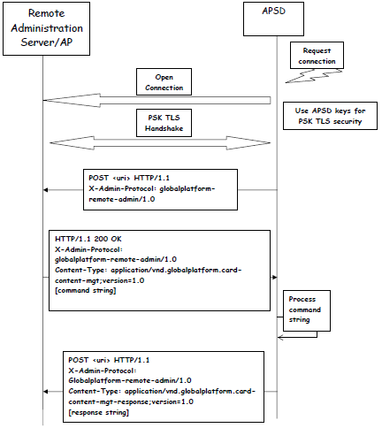
RxM over HTTP: Elements & Communication Flow
Communication Flow

Slide 43
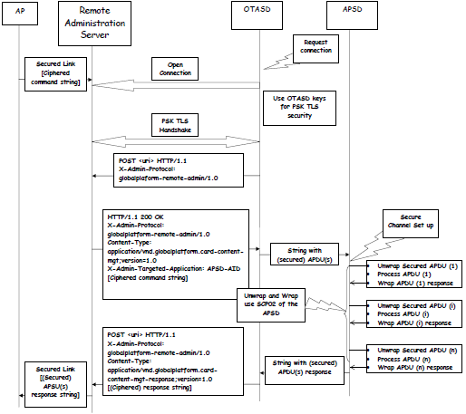
RxM over HTTP: Elements & Communication Flow
Communication Flow
with Intermediary Actor

Slide 44
RxM over HTTP: Product Configuration
Product Configuration: Security Domain Installation
Secure Chanel Protocol
Security Domain Administration Session Parameters
Admin Agent Configuration Parameters
PSK TLS Key Set
Morpho Specifications:
Admin Agent Component
Admin Agent Component - RAM over HTTP Extension

Slide 45
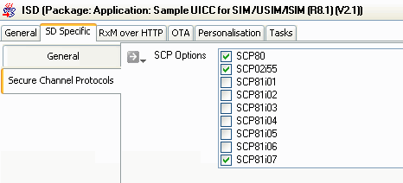
RxM over HTTP: Product Configuration
Secure Chanel Protocol Identifier (GP2.2 Amnd B)
SCP81i01 = TLS 1.0
SCP81i02 = TLS 1.1
SCP81i03 = TLS 1.0 + TLS 1.1
SCP81i04 = TLS 1.2
SCP81i05 = TLS 1.2 + TLS 1.0
SCP81i06 = TLS 1.2 + TLS 1.1
SCP81i07 = TLS 1.2 + TLS 1.1 + TLS 1.0

Slide 46
RxM over HTTP: Product Configuration
Administration Session Triggering Parameters – process of creation
RAM over HTTP Admin Session Parameters
Delivered to Applet
identified by TAR of
Default parameters of Triggered
OTA message
Security Domain handed over
Trigger SMS
during installation within the
parameters
'C9' Tag
Triggered Security
Parameters of Issuer
Domain parameters
Security Domain handed
add missing
over during installation
parameters
within the 'C9' Tag
Issuer Security Domain
parameters
add missing
parameters

Slide 47
RxM over HTTP: Product Configuration
Security Domain Administration Session Parameters (GP2.2 Amnd B)

Slide 48
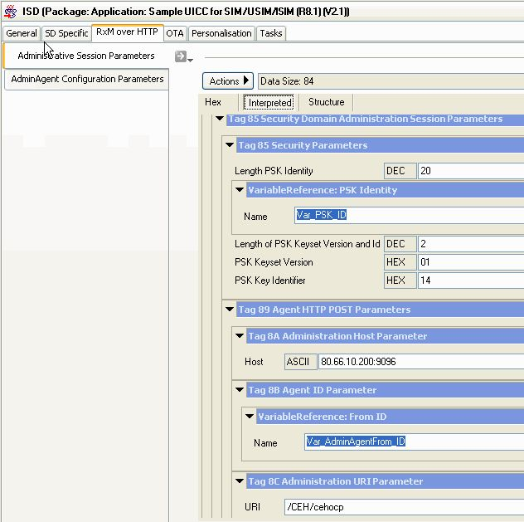
RxM over HTTP: Product Configuration
Security Domain Administration Session Parameters (GP2.2 Amnd B)

Slide 49
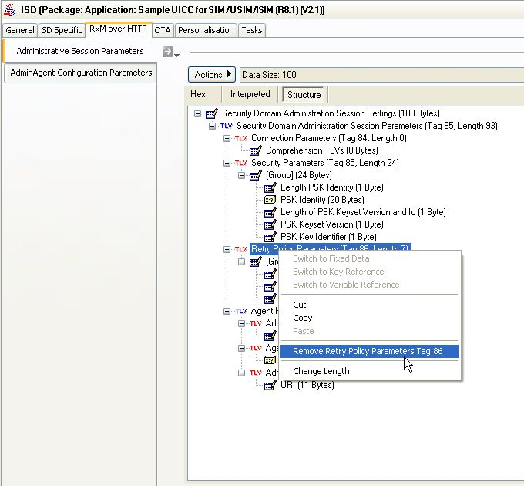
RxM over HTTP: Product Configuration
Security Domain Administration Session Parameters (GP2.2 Amnd B)

Slide 50
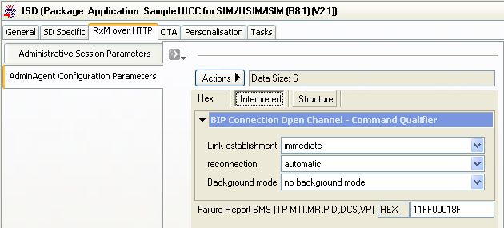
RxM over HTTP: Product Configuration
Admin Agent Configuration Parameters (proprietary)

Slide 51
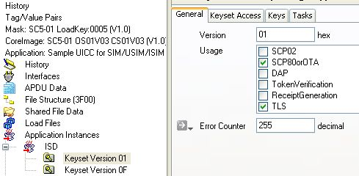
RxM over HTTP: Product Configuration
PSK TLS Key Set (GP2.2 Amnd B)
Keyset Usage must include “TLS”

Slide 52
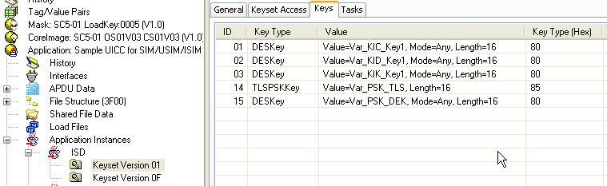
RxM over HTTP: Product Configuration
PSK TLS Key Set (GP2.2 Amnd B)
PSK TLS Key: key version and key ID freely defined
DEK Key must use same key version and key ID increased by 1

Slide 53
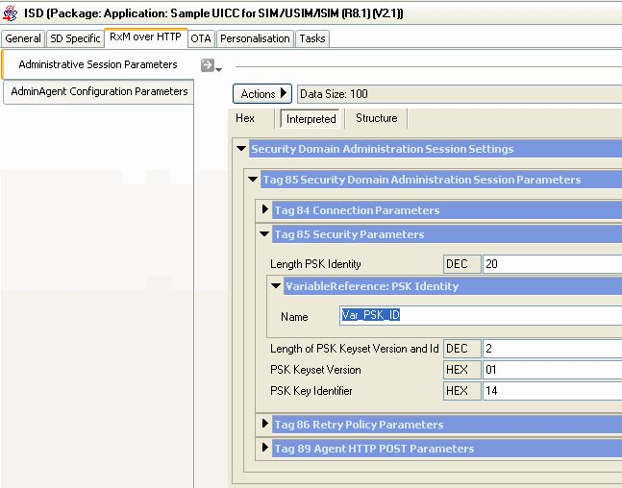
RxM over HTTP: Product Configuration
PSK TLS Key Set (GP2.2 Amnd B)
Keyset and PSK Key ID must match entry in Security Parameters of Admin. Session Parameters

Slide 54
L ONG TERM E VOLUTION UICC: RxM over HTTP GTS (Global Technical Support) detlef.balks@morpho.com

